Slide 1

Mobile Application Development
Welcome
Class: BS(CS)-VII
Sukkur IBA University – Kandhkot Campus
Week - 07
Lecture – 13
Your Facilitator, Adil Khan

Slide 2
Menus

Slide 3
Menus
A menu is a set of options.
The user can select from a menu to perform a function.
For example searching for information, saving information, editing information, or navigating to a screen.

Slide 4
Types of Menus
Options menu: Appears in the app bar and provides the primary options that affect use of the app itself. Examples of menu options: Search to perform a search, Share to share a link, and Settings to navigate to a Settings Activity.
Contextual menu: Appears as a floating list of choices when the user performs a long tap on an element on the screen. Examples of menu options: Edit to edit the element, Delete to delete it, and Share to share it over social media.

Slide 5
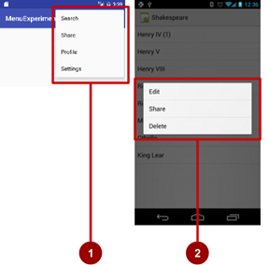
Types of Menus
Options menu:
Contextual menu:

Slide 6
Options Menus
Create Android Options Menu in XML File
XML menu resource. Create an XML menu resource file for the menu items, and assign appearance and position attributes as described in the next section.
Inflating the menu. Override the onCreateOptionsMenu() method in your Activity to inflate the menu.
Handling menu-item clicks. Menu items are View elements, so you can use the android:onClick attribute for each menu item. However, the onOptionsItemSelected() method can handle all the menu-item clicks in one place and determine which menu item the user clicked, which makes your code easier to understand.
Performing actions. Create a method to perform an action for each options menu item.

Slide 7
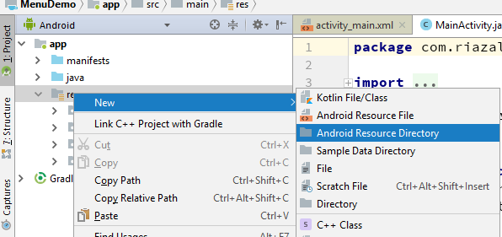
Options Menus
Create Android Options Menu in XML File
In android, to define options menu, we need to create a new folder menu inside of our project resource directory (res/menu/) and add a new XML file to build the menu.

Slide 8
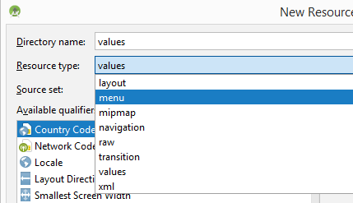
Options Menus
Create Android Options Menu in XML File

Slide 9
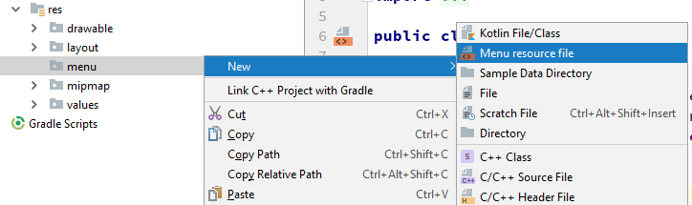
Options Menus
Create Android Options Menu in XML File

Slide 10
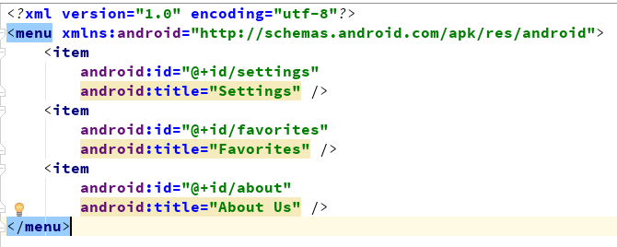
Options Menus
Create Android Options Menu in XML File

Slide 11
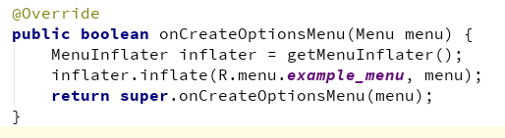
Options Menus
Load Android Options Menu from an Activity
To specify the options menu for an activity, we need to override onCreateOptionsMenu() method and load the defined menu resource using MenuInflater.inflate() like as shown below.

Slide 12
Options Menus
Load Android Options Menu from an Activity
If you observe above code, we are calling our menu using MenuInflater.inflate() method in the form of R.menu.menu_file_name. Here our xml file name is example_menu.xml so we used file name example_menu.xml.

Slide 13
Options Menus
Load Android Options Menu from an Activity
onCreateOptionsMenu() initializes the contents of the Activity's standard options menu.
This is only called once, the first time the options menu is displayed.

Slide 14
Options Menus
Handle Android Options Menu Click Events
In android, we can handle options menu item click events using the onOptionsItemSelected() event method.

Slide 15
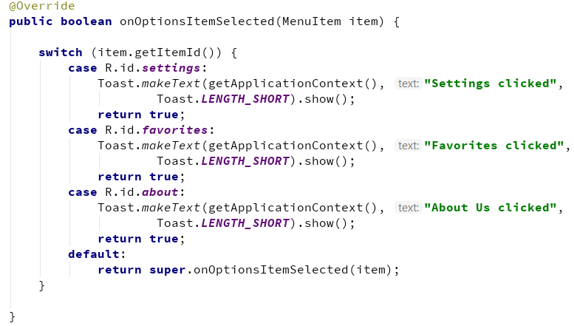
Options Menus
Handle Android Options Menu Click Events

Slide 16
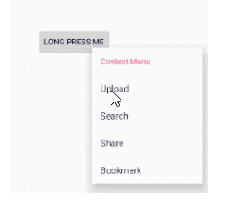
Context Menus
In android, Context Menu is like a floating menu and that appears when the user performs a long press or click on an element and it is useful to implement actions that affect the selected content or context frame.
The android Context Menu is more like the menu which displayed on right-click in Windows or Linux.

Slide 17
Steps for creating Context Menu
Create XML menu resource file
Register View using registerForContextMenu()
Implement onCreateContextMenu() in Activity to inflate menu
Implement onContextItemSelected() to handle menu item clicks
Create method to perform action for each context menu item

Slide 18
Create menu resource
Create XML menu resource (menu_context.xml)
<item
android:id="@+id/context_edit"
android:title="Edit"
android:orderInCategory="10"/>
<item
android:id="@+id/context_share"
android:title="Share"
android:orderInCategory="20"/>

Slide 19
Create menu resource
Use the android:orderInCategory attribute to specify the order in which the menu items appear in the menu, with the lowest number appearing higher in the menu.
This is usually the order of importance of the item within the menu.

Slide 20
Register a view to a context menu
In onCreate() of the Activity:
Register View.OnCreateContextMenuListener to View:
TextView article_text = findViewById(R.id.article);
registerForContextMenu(article_text);

Slide 21
Implement onContextItemSelected()
@Override
public boolean onContextItemSelected(MenuItem item) {
switch (item.getItemId()) {
case R.id.context_edit:
editNote();
return true;
case R.id.context_share:
shareNote();
return true;
default:
return super.onContextItemSelected(item);
}
}

Slide 22
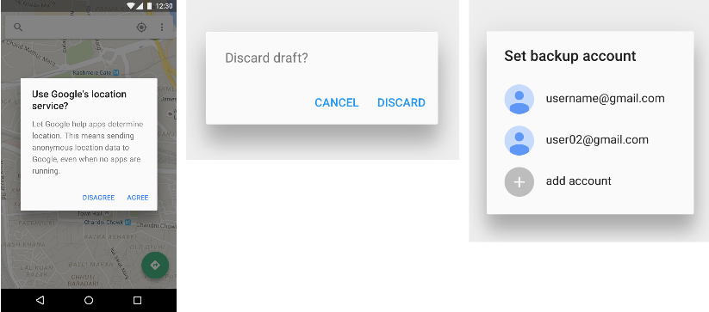
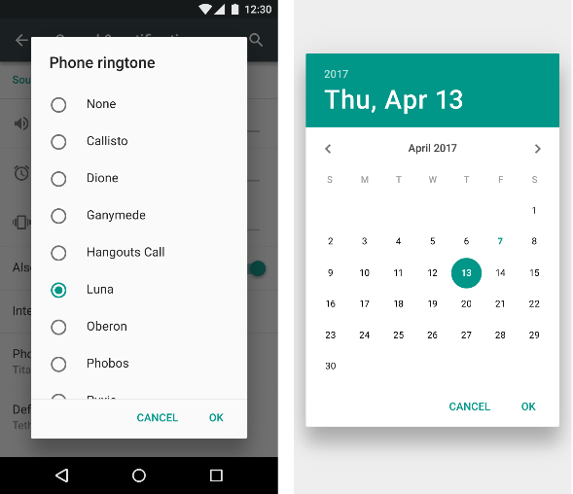
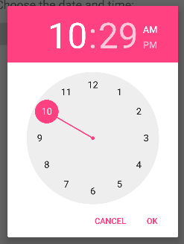
Dialogs
Dialog appears on top, interrupting flow of Activity
Requires user action to dismiss

Slide 23
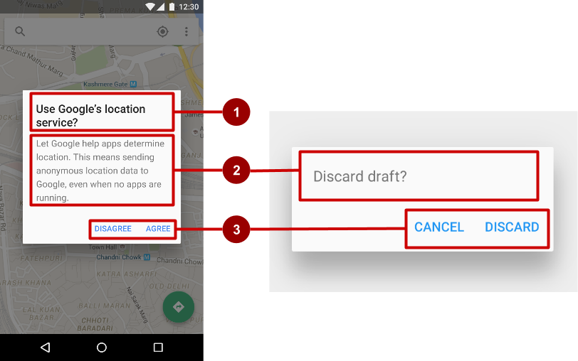
AlertDialog
AlertDialog can show:
Title (optional)
Content area
Action buttons

Slide 24
Build the AlertDialog
Use AlertDialog.Builder to build alert dialog and set attributes:
public void onClickShowAlert(View view) {
AlertDialog.Builder alertDialog = new
AlertDialog.Builder(MainActivity.this);
alertDialog.setTitle("Connect to Provider");
alertDialog.setMessage(R.string.alert_message);
// ... Code to set buttons goes here.

Slide 25
Set the button actions
alertDialog.setPositiveButton()
alertDialog.setNegativeButton()

Slide 26
alertDialog code example
alertDialog.setPositiveButton(
"OK", newDialogInterface.OnClickListener() {
public void onClick(DialogInterface dialog, int which) {
// User clicked OK button.
}
});
Same pattern for setNegativeButton()

Slide 27
Thank you!
Any Questions???

